Slide 1




AT82.02
Data Modeling and Management
Unit 1-5: Relational DB Design using ER to Relational Mapping
Chutiporn Anutariya (chuti at ait dot ac dot th)

Slide 2

Relational Database Design by ER-to-Relational Mapping
Design a relational database schema
Based on a conceptual schema design
Seven-step algorithm to convert the basic ER model constructs into relations

Slide 3
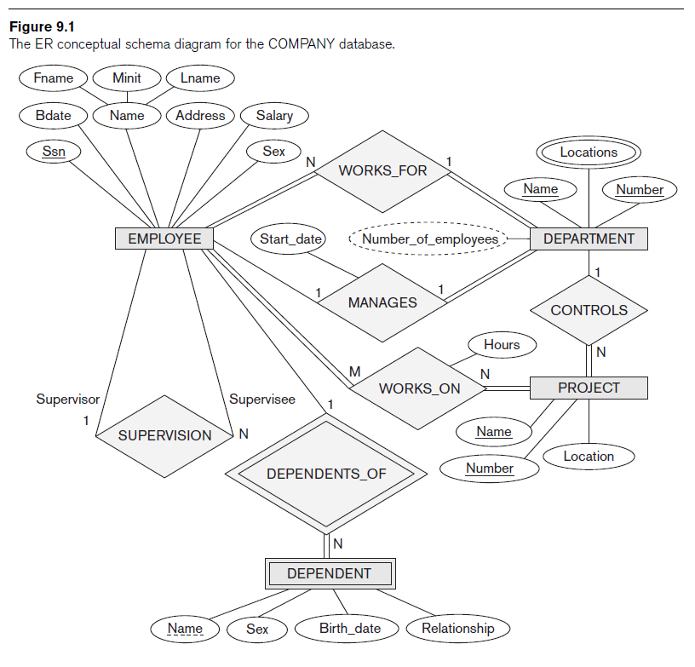
Relational Database Design Using ER-to-Relational Mapping

Slide 4
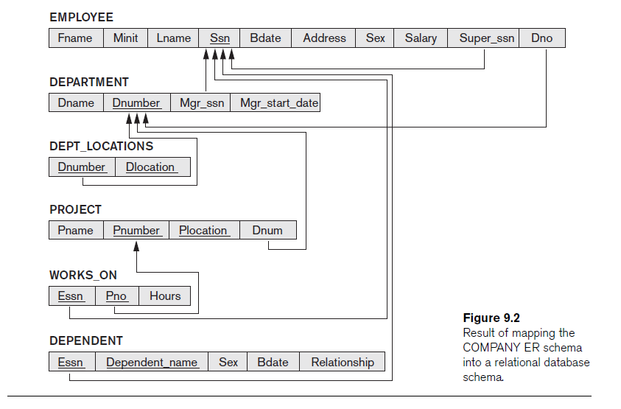

Slide 5
Mapping Algorithm: Step 1
Step 1: Mapping of Regular Entity Types
For each regular entity type, create a relation R that includes all the simple attributes of E
Called entity relations
Each tuple represents an entity instance
COMPANY database example
Assume that the mapping will create tables with simple single-valued attributes

Slide 6
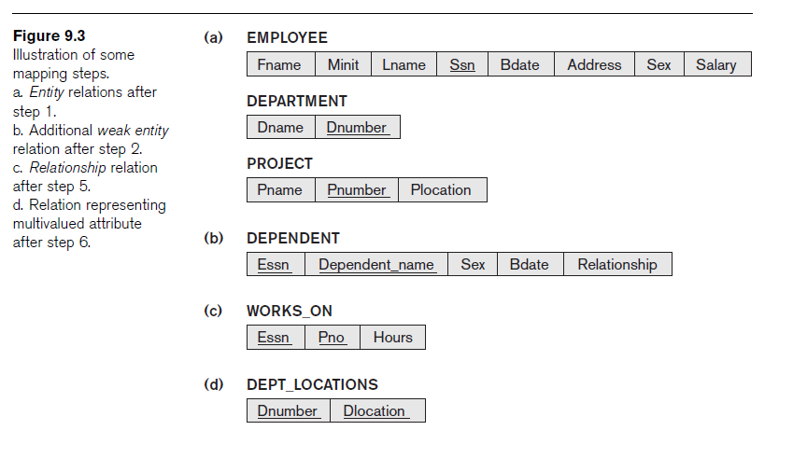
COMPANY DB after Step 1

Slide 7
Mapping Algorithm: Step 2
Step 2: Mapping of Weak Entity Types
For each weak entity type, create a relation R and include all simple attributes of the entity type as attributes of R
Include primary key attribute of owner as foreign key attributes of R

Slide 8
COMPANY DB after Step 2

Slide 9
Mapping Algorithm: Step 3
Step 3: Mapping of Binary 1:1 Relationship Types
For each binary 1:1 relationship type
Identify relations that correspond to entity types participating in R
Possible approaches:
Foreign key approach
Merged relationship approach
Crossreference or relationship relation approach

Slide 10
Mapping Algorithm: Step 4
Step 4: Mapping of Binary 1:N Relationship Types
For each regular binary 1:N relationship type
Identify relation that represents participating entity type at N-side of relationship type
Include primary key of other entity type as foreign key in S
Include simple attributes of 1:N relationship type as attributes of S
Alternative approach
Use the relationship relation (cross-reference) option as in the third option for binary 1:1 relationships

Slide 11
Mapping Algorithm: Step 5
Step 5: Mapping of Binary M:N Relationship Types
For each binary M:N relationship type
Create a new relation S
Include primary key of participating entity types as foreign key attributes in S
Include any simple attributes of M:N relationship type

Slide 12
COMPANY DB after Step 5

Slide 13
Mapping Algorithm: Step 6
Step 6: Mapping of Multivalued Attributes
For each multivalued attribute
Create a new relation
Primary key of R is the combination of A and K
If the multivalued attribute is composite, include its simple components

Slide 14
COMPANY DB after Step 6

Slide 15
ER-to-Relational Mapping Algorithm: Step 7
Step 7: Mapping of N-ary Relationship Types
For each n-ary relationship type R
Create a new relation S to represent R
Include primary keys of participating entity types as foreign keys
Include any simple attributes as attributes

Slide 16
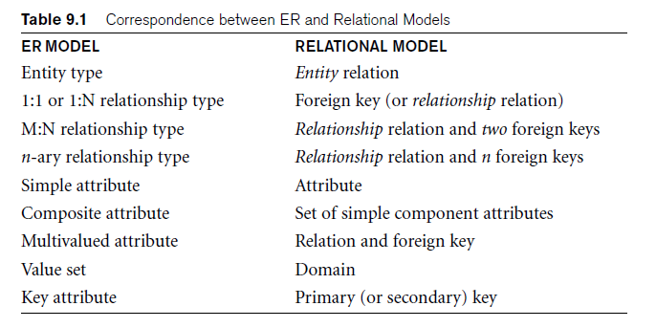
Summary of Mapping for ER Model Constructs

Slide 17
References
R. Elmasri and S. Navathe: Fundamentals of Database Systems, 7/E, Addison-Wesley, 2015

